Slide 1

CSE0613-2201 System Analysis & Design
Systems Analysis and Design
Partho Sarathi Sarker
Asst. Professor
Dept. of Computer Science and Engineering(CSE)
University of Global Village (UGV)

Slide 2
System Analysis & Design
Course Code: | CSE 0613-2201 | Credits: | 02
 |  | CIE Marks: | 60
Exam Hours: | 02 | SEE Marks: | 40
Course Learning Outcome (CLOs): After Completing this course successfully, the student will be able to…
CLO1 | Understand fundamental principles and methodologies of system analysis and design.
CLO2 | Apply system analysis techniques to gather requirements and develop models.
CLO3 | Design system architecture, interfaces, and data structures using appropriate tools and strategies.
CLO4 | Evaluate and implement system development methodologies, scalability, performance, and security mechanisms.
CLO5 | Develop, test, and deploy system designs through practical projects and real-world applications.

Slide 3
Summary of Course Content
Sl. No. | COURSE CONTENT | HRs | CLOs
1 | System Design & Analysis: SDLC stages, system development methodologies | 2 | CLO1 & CLO2
2 | System Elements & Types: Elements, types of systems, and system categories | 2 | CLO1
3 | Information Systems & Role of Analyst and Planning: MIS, DSS, TPS, and role of system analyst & analysis strategies | 2 | CLO1, CLO2 & CLO3
4 | Structured Analysis & Models: DFDs, ER diagrams & data dictionaries | 2 | CLO4
5 | Implementation & Testing: System coding, unit testing, system integration | 2 | CLO5
“Systems Analysis and Design” by Elias M Awad
"Object-Oriented Systems Analysis and Design Using UML" by Simon Bennett, Steve McRobb and Ray Farmer, 2nd Edition
"Systems Analysis and Design" by Kenneth E. Kendall and Julie E. Kendall, 10th Edition

Slide 4
Assessment Pattern
Bloom's Category Marks (out of 90) | Tests (30) | Assignments (10) | Quizzes (10) | Attendance (10)
Remember | 04 | 03
Understand | 05 | 02 | 04
Apply | 06 | 03 | 03
Analyze | 05
Evaluate | 05 | 02 | 03
Create | 05
SEE- Semester End Examination (40 Marks)
Bloom's Category | Test
Remember | 05
Understand | 05
Apply | 13
Analyze | 07
Evaluate | 05
Create | 05

Slide 5
Course Plan
Week | Topics | Teaching Strategy | Assessment Strategy | Mapped CLO(s)
1 | Introduction to Systems | Lecture, multimedia, discussions | Feedback, Q&A, assessment | CLO1
2 | System Elements and Categories | Lecture, discussions | Q&A, Midterm assessments | CLO1
3 | Introduction to Systems Analysis | Lecture, multimedia | Midterm assessments | CLO1, CLO2
4 | Techniques in Systems Analysis | Lecture, discussions | Midterm assessments | CLO2
5 | System Design Principles | Lecture, discussions | Feedback, Q&A, assessment | CLO1, CLO3
6 | System Design Tools | Lecture, multimedia, discussions | Q&A, assignments | CLO3
7 | SDLC Overview | Lecture, multimedia, discussions | Ethical analysis, Final assessments | CLO1, CLO2
8 | SDLC - System Design | Interactive lectures, examples from real-world applications | Final term assessments | CLO3

Slide 6
Course Plan
Week | Topics | Teaching Strategy | Assessment Strategy | Mapped CLO(s)
9 | Implementation Strategies | Lecture, multimedia, discussions | Final term assessments | CLO4
10 | Testing in Systems Design | Revision through Q&A, group activities | Participation, group evaluation | CLO4
11 | Scalability and Performance | Lecture, multimedia, discussions | Feedback, Q&A, assessment | CLO4
12 | Security in System Design | Lecture, discussions | Q&A, Midterm assessments | CLO4
13 | Advanced Analysis Techniques | Lecture, multimedia | Midterm assessments | CLO2, CLO4
14 | Challenges in System Design | Lecture, discussions | Midterm assessments | CLO4
15 | Roles and Responsibilities | Lecture, discussions | Feedback, Q&A, assessment | CLO1, CLO2
16 | Real-World Applications | Lecture, multimedia, discussions | Q&A, assignments | CLO5
17 | Capstone Project and Review | Lecture, multimedia, discussions | Ethical analysis, Final assessments | CLO5

Slide 7
week 1&2 Systems Analysis and Design Basics

Slide 8
Systems Analysis and Design
Systems development is systematic process which includes phases such as planning, analysis, design, deployment, and maintenance.
Systems analysis
Systems design

Slide 9
Systems Analysis
It is a process of collecting and interpreting facts, identifying the problems, and decomposition of a system into its components.
System analysis is conducted for the purpose of studying a system or its parts in order to identify its objectives. It is a problem solving technique that improves the system and ensures that all the components of the system work efficiently to accomplish their purpose.
Analysis specifies what the system should do.

Slide 10
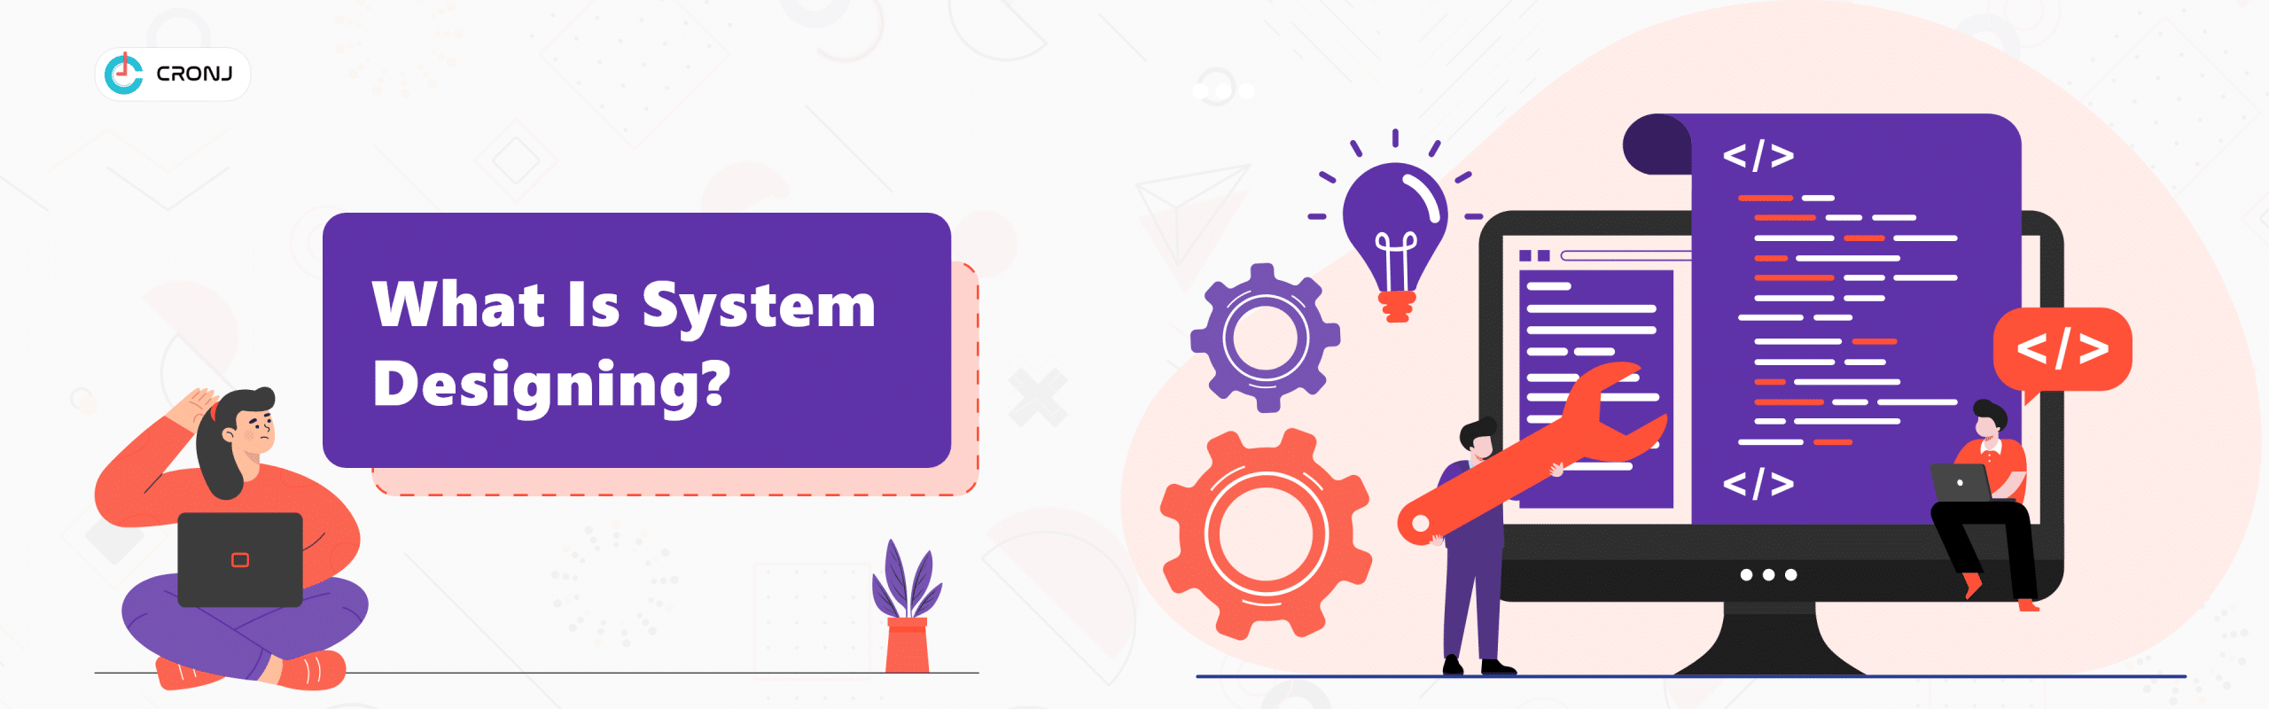
Systems Design
It is a process of planning a new business system or replacing an existing system by defining its components or modules to satisfy the specific requirements.
Before planning, you need to understand the old system thoroughly and determine how computers can best be used in order to operate efficiently.
System Design focuses on how to accomplish the objective of the system.

Slide 11
Properties of Systems
Organization
Interaction
Interdependence
Integration
Integration
Central Objective

Slide 12

Properties of Systems
Organization
Organization implies structure and order. It is the arrangement of components that helps to achieve predetermined objectives.
An organization or organisation is an entity—such as a company, or corporation or an institution (formal organization), or an association—comprising one or more people and having a particular purpose.

Slide 13
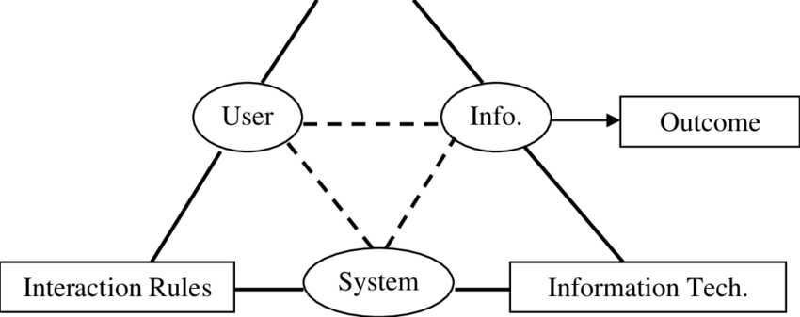
Properties of Systems
Interaction
Interaction defined by the manner in which the components operate with each other. For example, in an organization, purchasing department must interact with production department and payroll with personnel department.
Interdependence
Interdependence means how the components of a system depend on one another. For proper functioning, the components are coordinated and linked together according to a specified plan. The output of one subsystem is the required by other subsystem as input

Slide 14
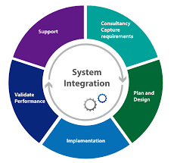
Properties of Systems
Integration
Integration is concerned with how a system components are connected together. It means that the parts of the system work together within the system even if each part performs a unique function.
Central Objective
The objective of system must be central. It may be real or stated. It is not uncommon for an organization to state an objective and operate to achieve another.
The users must know the main objective of a computer application early in the analysis for a successful design and conversion.

